Slide 1

IOT Based Automatic Vehicle Accident Detection and Rescue System
by
G. Thahaseen
Roll No. 224G1A33B9
K. Soumya Latha
Roll No. 224G1A33A3
M.Simhadri Naik
Roll No. 234G5A3309
P. Venkata Jagadeeswara Reddy
Roll No. 234G5A3312
Under the guidance of
^{Mrs. Gayatri}
Assistant Professor M. Tech.
Department of Computer Science and Engineering (AI & ML)
Srinivasa Ramanujan Institute of Technology
(Affiliated to JNTUA & Approved by AICTE) (Accredited by NAAC with ‘A’ Grade & Accredited by NBA (EEE, ECE & CSE)
Rotarypuram Village, B K Samudram Mandal, Ananthapuramu – 515715.
2025 - 2026
B-15
Dept.of.Computer science and Engineering(AI&ML)
Srinivasa Ramanujan Institute of Technology

Slide 2
Contents
IOT Based Automatic Vehicle Accident Detection and Rescue System
Abstract
Introduction
Literature survey
Proposed Work
References
GitHub Link
Queries
B-15
Srinivasa Ramanujan Institute of Technology
2

Slide 3
Abstract
IOT Based Automatic Vehicle Accident Detection and Rescue System
Road accidents often happen suddenly, and sometimes help takes too long to arrive because the accident is not reported quickly. Most current systems need someone to call for help or don’t detect accidents right away. This project creates an IoT-based system that uses sensors and GPS to automatically detect accidents and find the exact location. When a crash occurs, the system sends a message with details and location to emergency services using GSM. This helps rescue teams get to the scene faster, especially in remote or less busy areas. It works automatically without needing anyone to make a call, which can save lives. Quick detection and immediate alerts can reduce the time taken for medical help, lowering deaths and serious injuries on the road.
B-15

Slide 4
Introduction
IOT Based Automatic Vehicle Accident Detection and Rescue System
Road accidents are a major cause of death and injury, and in many cases, help arrives late because the accident is not reported in time.
Traditional systems depend on people to report accidents, which can lead to delays and reduce the chances of saving lives.
To solve this problem, our project uses IoT technology with sensors, GPS, and a microcontroller to automatically detect accidents and send the location to emergency services
The system works without human help. It can detect a crash using sensors and immediately send alerts through GSM to hospitals and rescue teams.
B-15

Slide 5
Literature Survey
IOT Based Automatic Vehicle Accident Detection and Rescue System
No | Title | Author | Journal Name & Year | Methodology Adapted | Key Findings | Gaps
1. | IoT-based Vehicular Accident Detection Using a Deep Learning Model | Ishu Rani et al. | Int. Journal of Autonomous and Adaptive Communications Systems, 2025 | IoT sensors with deep learning model for accident severity detection | High accuracy in detecting and classifying accidents using real-time data | Depends on quality of dataset; not tested in all real-world environments
 | Smart IoT-based Accident Monitoring and Rescue System | Sujithra G. et al. | Journal of IoT in Social, Mobile, Analytics, and Cloud, 2024 | Arduino + multiple IoT sensors (accelerometer, GPS, MQ3, GSM) for real-time alert system | Accurate accident detection and alerting with live location | May face false positives; needs sensor calibration for different vehicles
3
4
5
Srinivasa Ramanujan Institute of Technology

Slide 6
Proposed Work
IOT Based Automatic Vehicle Accident Detection and Rescue System
Accident Detection Using IoT Sensors: Use motion sensors and GPS to quickly detect if a vehicle has crashed.
Real-Time Location Tracking: Keep track of the vehicle’s location at all times using GPS, so the accident spot is easy to find.
Instant Alert and Notification System: Send automatic messages with the location to family, rescue teams, or hospitals when an accident happens.
User Interface for Monitoring and Alerts: Create a simple app or screen to show vehicle info, accident alerts, and location.
System Reliability and Testing: Test the system in different situations to make sure it works well and avoids sending false alerts.
Driver Health Monitoring: Use heart rate sensors to continuously check the driver’s vital signs and send health status along with accident alerts to prioritize medical help.
AI-Based Camera Scene Analysis: Integrate a camera and AI to capture and analyze accident scenes, estimating crash severity and number of people involved for better rescue planning.
Backup Power Supply: Include a rechargeable battery backup to keep the accident detection and alert system running even if the vehicle’s main power fails after a crash.
B-15

Slide 7
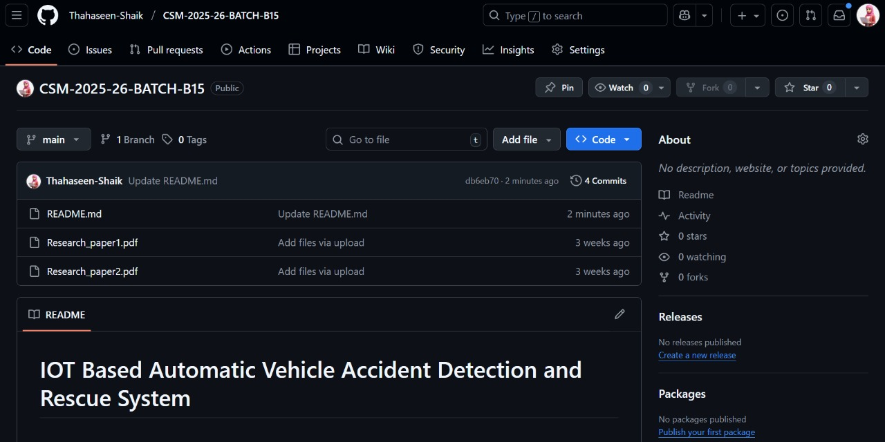
Github Dashboard
IOT Based Automatic Vehicle Accident Detection and Rescue System
B-15

Slide 8
Any Queries?
IOT Based Automatic Vehicle Accident Detection and Rescue System
Srinivasa Ramanujan Institute of Technology

Slide 9
Thank You!!!
Srinivasa Ramanujan Institute of Technology

